Slide 1
What is Data Science?
Shahriar’s Analytical Academy

Slide 2
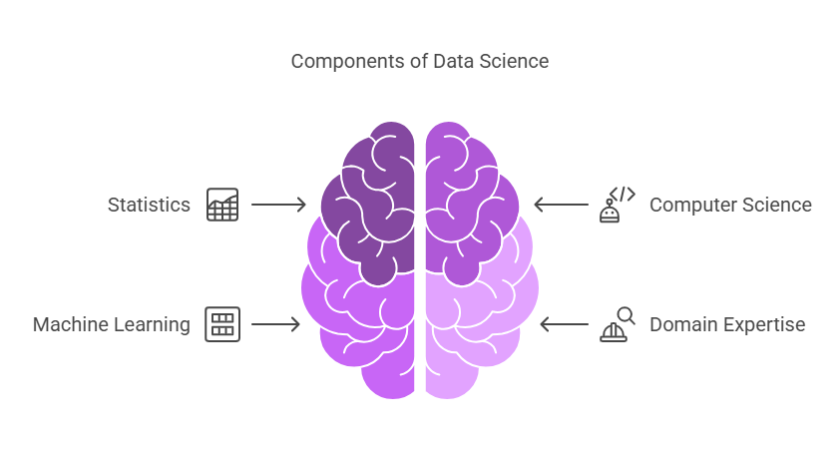
Definition of Data Science
Data Science is an interdisciplinary field that combines techniques from statistics, computer science, machine learning, and domain expertise to extract meaningful insights from structured and unstructured data. It involves analyzing large volumes of data, identifying patterns, and using predictive models to make informed decisions.
Notes:
Data Science is a field that blends knowledge from different areas like statistics, computer science, machine learning, and specific industries to understand and use data effectively. It focuses on analyzing both organized and disorganized data, looking for patterns, and creating models that can predict future outcomes. This helps in making smart decisions based on data-driven insights. For example, a retail company can use data science to analyze customer buying behavior, predict which products are likely to sell well, and plan their inventory accordingly.

Slide 3
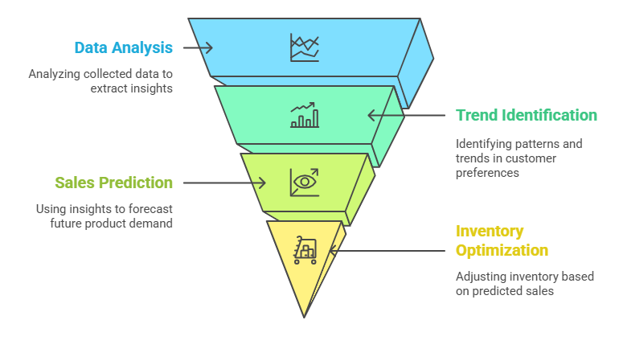
Example to understand
Data Science
Scenario
Imagine you are a business analyst at a retail company. You want to understand customer preferences and predict which products will be in demand during the upcoming season.
Notes:
Imagine you are a business analyst working at a retail company. Your goal is to understand what products customers are likely to buy in the upcoming season. To achieve this, you can apply data science, which is all about using data to make better decisions. The first step is to gather historical sales data, which gives you a record of how products have sold in the past. You also need to look at customer reviews, which can provide insights into how satisfied customers were with different products and why they liked or disliked them. Social media trends are another key piece of information—by analyzing what people are talking about and which products they are sharing or commenting on, you can get a sense of what is gaining popularity.
With all this data, you can now apply data science techniques such as predictive analytics and machine learning. Predictive analytics helps you to forecast future outcomes by analyzing patterns in the data. For instance, by recognizing trends in the past sales data, you can predict which products will likely see an increase in demand. Machine learning algorithms can further refine these predictions by learning from new data over time, improving the accuracy of future forecasts. These techniques help you identify what customers want before they even start buying, based on patterns in their previous behaviors.
The outcome of applying data science in this scenario is significant for the company. First, the company can use these insights to adjust its marketing strategy, ensuring they target customers with the right products at the right time. It can also optimize its inventory by stocking up on popular products, while avoiding excess stock of products that are predicted to sell less.

Slide 4
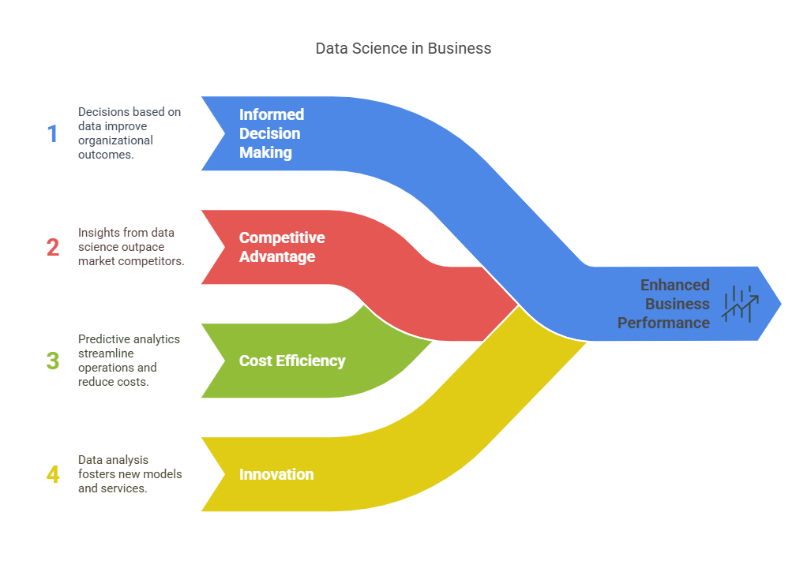
Importance of Data Science
Notes:
Data science plays a crucial role in helping organizations make better decisions and stay ahead in the market. First, it supports informed decision-making by allowing businesses to base their choices on data rather than relying on intuition or guesses. This ensures that decisions are grounded in facts, leading to more accurate and reliable outcomes. Additionally, data science provides a competitive advantage for companies. By analyzing data, organizations can gain valuable insights about customer preferences, market trends, and industry developments, helping them stay one step ahead of their competitors. It also improves cost efficiency. Through predictive models and data analysis, businesses can forecast trends, optimize inventory, and streamline operations, which helps them reduce waste, save money, and increase profits. Finally, data science drives innovation by uncovering new opportunities. By understanding market behavior and customer needs, businesses can develop new products, services, or business models that cater to emerging demands, leading to growth and long-term success.

Slide 5
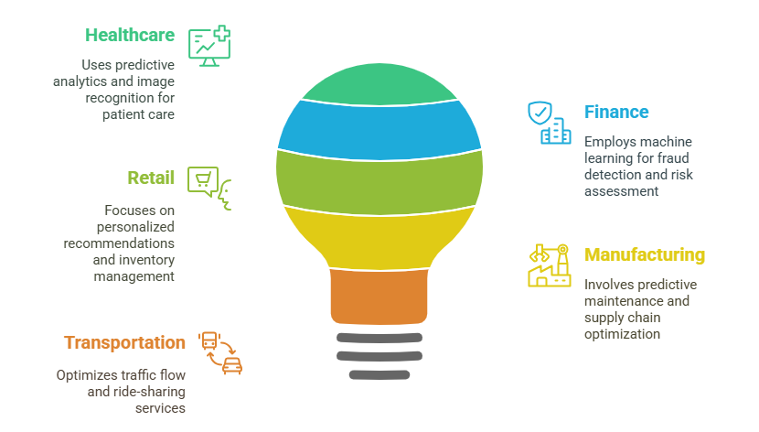
Application of Data Science
Notes:
Data science has numerous applications across various industries, helping improve efficiency, accuracy, and innovation. In healthcare, predictive analytics can be used to forecast patient outcomes, such as predicting the likelihood of recovery or complications. Image recognition is also employed to detect medical conditions like tumors in X-rays, helping doctors make quicker and more accurate diagnoses. In the finance industry, machine learning algorithms help detect fraud by identifying unusual patterns in transactions, preventing financial losses. Additionally, risk assessment models are used to evaluate the likelihood of loan defaults, aiding in better decision-making for lenders. In retail, data science enables companies like Amazon to offer personalized recommendations based on customer behavior and preferences. It is also used for inventory management by forecasting demand, helping businesses maintain optimal stock levels. Manufacturing industries use data science for predictive maintenance, which helps identify potential machine failures before they occur, minimizing downtime. It also aids in supply chain optimization by predicting demand and planning efficient routes for delivery. In transportation, data science is used to optimize traffic flow by analyzing data from smart sensors and GPS, reducing congestion. Ride-sharing services, like Uber, use data science to predict rider demand and optimize routes for drivers, improving service efficiency and customer satisfaction.

Slide 6
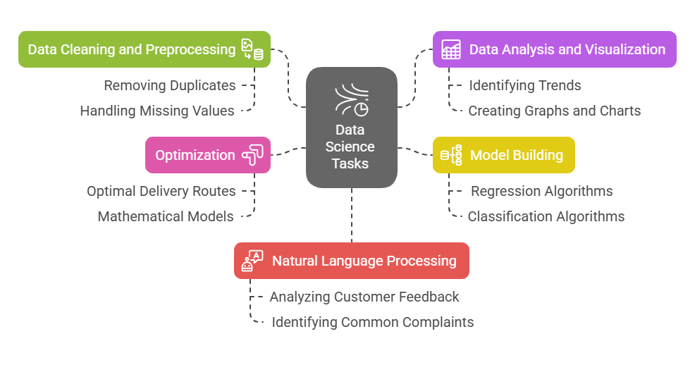
Examples of Task-Based Use Cases
Notes:
Data science involves a variety of tasks that help organizations make sense of data and extract valuable insights.
Data Cleaning and Preprocessing is one of the foundational tasks. It involves removing duplicates, handling missing values, and formatting data so that it's ready for analysis. For example, when preparing a large dataset of customer reviews for sentiment analysis, data cleaning ensures that the dataset is accurate, consistent, and free of errors, making it reliable for further analysis.
Data Analysis and Visualization involves identifying trends in data and presenting the results in an easily understandable way through graphs and charts. For instance, by analyzing sales data over the past year, you can identify seasonal trends that can guide marketing strategies and inventory management decisions. Visualization tools help in presenting these findings to stakeholders.
Model Building is where predictive models are created using machine learning algorithms like regression or classification. A common use case is predicting customer churn using historical customer data. This helps businesses understand which customers are likely to leave and take action to retain them, improving customer retention rates.
Optimization involves using mathematical models to find the best possible solution to a problem. A logistics company might use optimization techniques to determine the most efficient delivery routes, minimizing costs and delivery times, and improving customer satisfaction.
Natural Language Processing (NLP) is used to analyze text data and extract meaningful insights. For example, analyzing customer feedback can help identify common complaints, which can be used to improve products or services. By processing and understanding text data, businesses can address customer concerns more effectively.

Slide 7
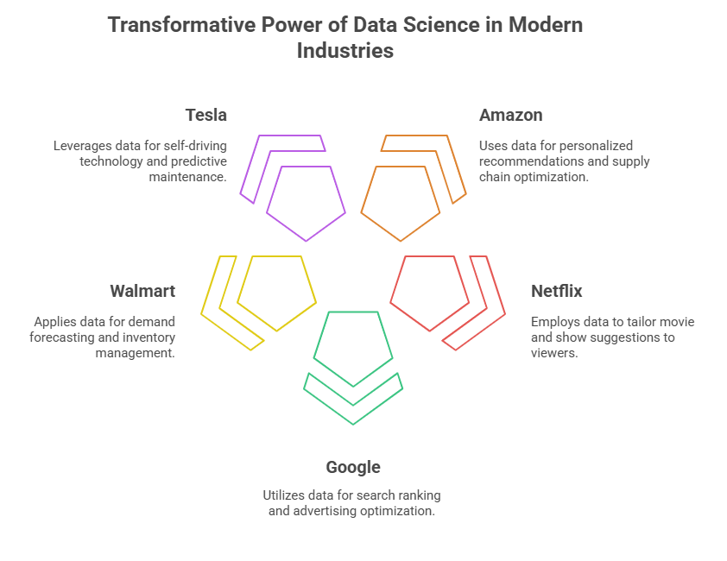





Examples of Large Companies Using Data Science
Notes:
Large companies across various industries leverage data science to enhance their operations, improve customer experiences, and stay ahead of the competition.
Amazon uses data science for personalized recommendations by analyzing customer behavior and purchase history. It also applies dynamic pricing, adjusting prices in real-time based on market conditions, demand, and customer preferences. Additionally, Amazon uses data science to optimize its supply chain, ensuring that products are delivered efficiently and on time based on customer demand.
Netflix relies on data science for its recommendation system, which suggests movies and TV shows tailored to a user's viewing history and preferences. By analyzing patterns in how users interact with content, Netflix can personalize its suggestions and keep viewers engaged.
Google uses data science in various ways, including search ranking algorithms that determine the most relevant results for user queries. It also optimizes its advertising through machine learning, ensuring ads reach the right audience at the right time. Google Maps uses data science to predict traffic patterns, helping users avoid delays and find the quickest routes.
Walmart applies data science for supply chain optimization, ensuring that products are stocked in the right locations and quantities based on demand forecasting. It also uses historical sales data for inventory management, helping the company reduce waste and avoid stockouts.
Tesla employs data science in several areas, such as developing self-driving technology by analyzing data from its sensors to improve the vehicle's performance and safety. It also uses predictive maintenance, identifying potential issues before they happen, and optimizes energy consumption to ensure efficient use of the vehicle's power.

Slide 8
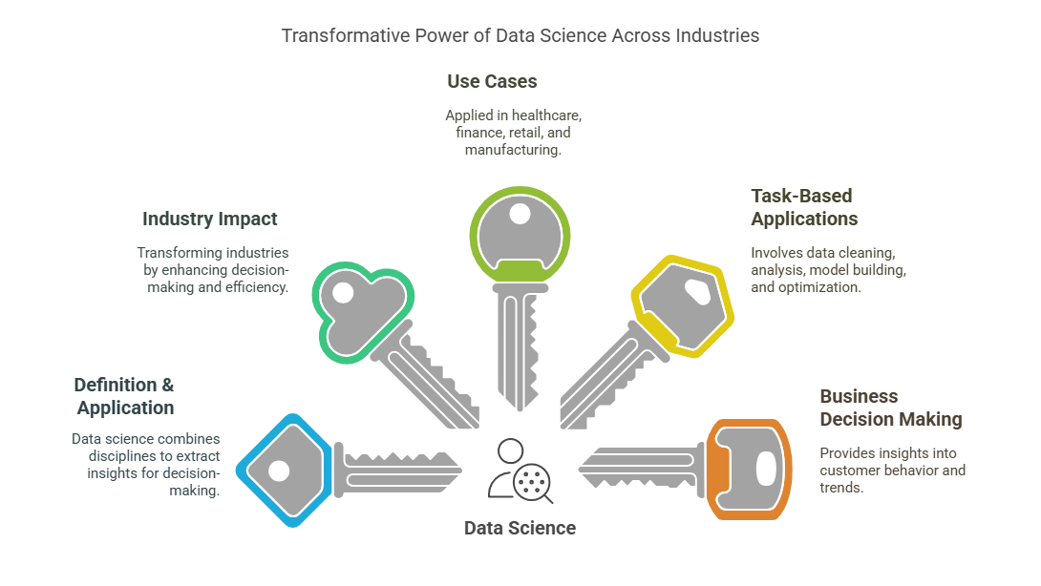
5 key learning points of this lesson
Notes:
In this lesson the key things we have learnt that Data science is an interdisciplinary field that integrates statistics, computer science, machine learning, and domain expertise to extract valuable insights from data. This allows for better decision-making, predictions, and optimizations in a wide variety of fields, improving overall performance.
Data science is revolutionizing industries by enabling businesses to make informed decisions based on data. It drives innovation by uncovering new opportunities, and improves operational efficiency in sectors like healthcare, finance, retail, and transportation, ultimately transforming how companies operate.
Data science is applied in different industries to solve specific problems. For example, in healthcare, predictive analytics is used to forecast patient outcomes; in finance, machine learning detects fraud; in retail, personalized recommendations enhance the customer experience; and in manufacturing, predictive maintenance ensures machine reliability.
Data science involves various tasks such as data cleaning (removing errors), data analysis (identifying trends), model building (creating predictive models), and optimization (finding the best solutions). Each of these tasks plays an important role in enabling businesses to make data-driven decisions and improve processes.
Data science enhances business decision-making by providing actionable insights into customer behavior, market trends, and operational performance. By analyzing data, businesses can refine their marketing strategies, optimize inventory management, and develop products that align with customer needs, leading to improved overall outcomes.

Slide 9
Thank You!
Shahriar’s Analytical Academy

